Slide 1


Document Classification

Slide 2

GROUP - 5
Geerath Bhat
Joshua Daniel
Rushikesh Gore
Suraj Takkekar
Kedar Chougule
Rakhi

Slide 3

Business Objective:
Company’s usually receive huge number of Resumes/CV and have lots of financial documents everyday.
The document classification solution should significantly reduce the manual human effort in the HRM and financial department. It should achieve a higher level of accuracy and automation with minimal human intervention.

Slide 4

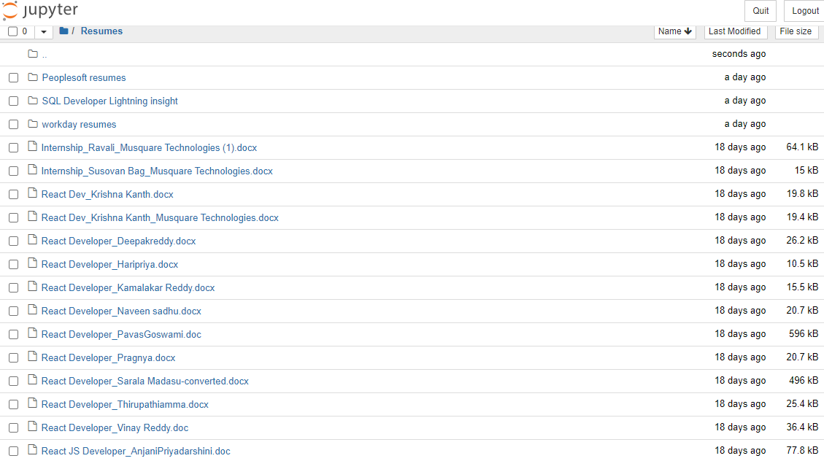
Dataset details :-
List of resumes

Slide 5
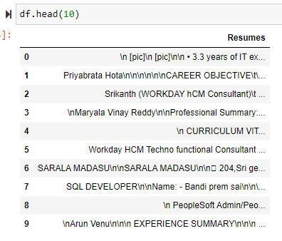
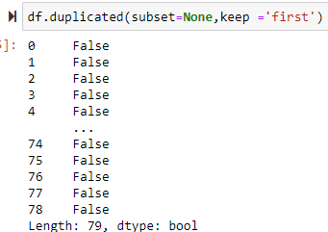
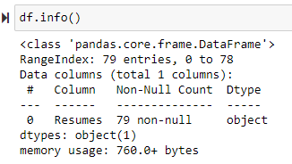
We used TEXTRACT library to read all the resumes into a DataFrame
Total of 79 resumes have been read into the dataframe
There are no null objects available in the dataframe
Duplicates are also not present in the dataframe

Slide 6
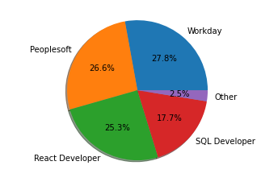
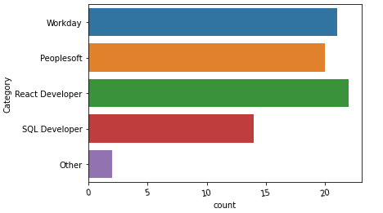
Exploratory Data Analysis (EDA) & Feature Engineering
We added a new column to label each resume into certain categories
As we can see from the above charts the resumes are divided evenly

Slide 7
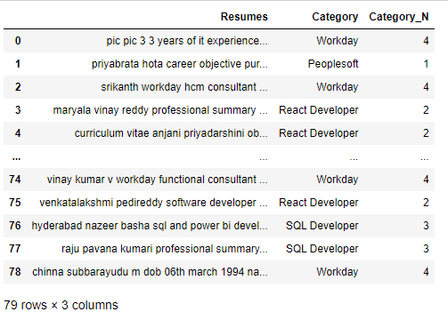
Data before and after cleaning
Before
After

Slide 8
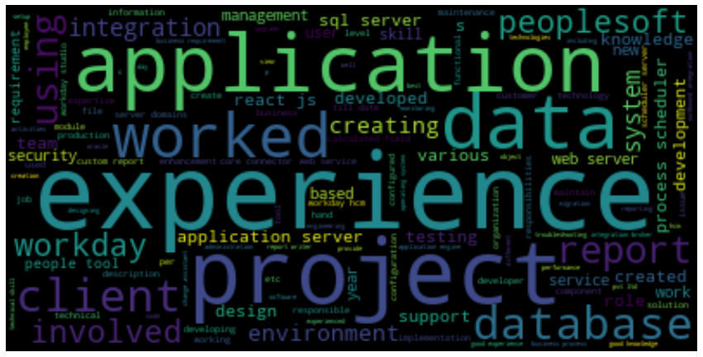
EDA - Common words

Slide 9
Model Building
The following models where tried for this project
KNeighbors Classifier
MultinomialNB Classifier
BernoulliNB Classifier
RandomForestClassifier
AdaBoostClassifier
GradientBoostingClassifier
ExtraTreesClassifier

Slide 10
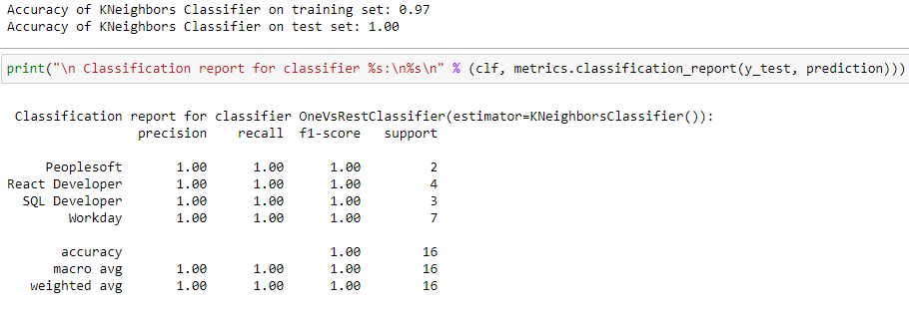
Model - KNeighborsClassifier
Algorithms
Algorithms
Data Partition details
classifier OneVsRestClassifier(
estimator=KNeighbors
Classifier())
80 % Data used for training
20 % Data used for testing

Slide 11
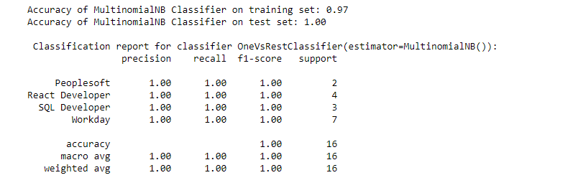
Model - MultinomialNB
Algorithms
Data Partition details
classifier OneVsRestClassifier(
estimator=MultinomialNB
Classifier())
80 % Data used for training
20 % Data used for testing

Slide 12
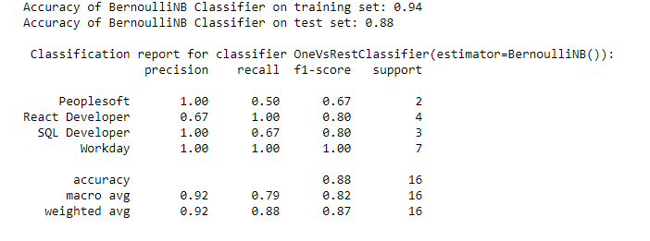
Model - BernoulliNB
Algorithms
Data Partition details
classifier OneVsRestClassifier(
estimator=BernoulliNB
Classifier())
80 % Data used for training
20 % Data used for testing

Slide 13
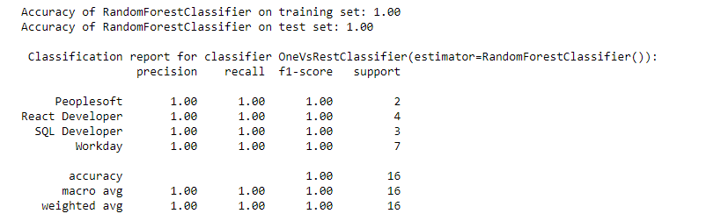
Model - RandomForestClassifier
Data Partition details
Algorithms
80 % Data used for training
20 % Data used for testing
classifier OneVsRestClassifier(
estimator=RandomForestClassifier())

Slide 14
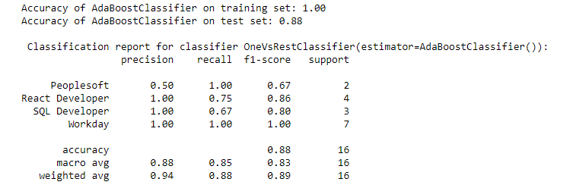
Model - AdaBoostClassifier
Algorithms
Data Partition details
classifier OneVsRestClassifier(
estimator=AdaBoostClassifier())
80 % Data used for training
20 % Data used for testing

Slide 15
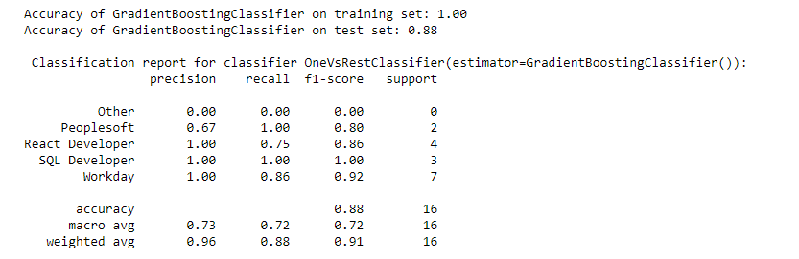
Model - GradientBoostingClassifier
Data Partition details
Algorithms
80 % Data used for training
20 % Data used for testing
classifier OneVsRestClassifier(
estimator=GradientBoostingClassifier())

Slide 16
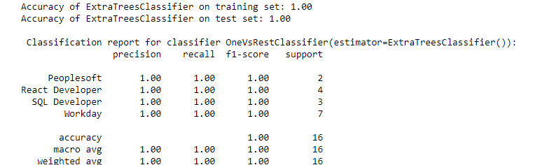
Model - ExtraTreesClassifier
Data Partition details
Algorithms
80 % Data used for training
20 % Data used for testing
classifier OneVsRestClassifier(
estimator=ExtraTreesClassifier())

Slide 17
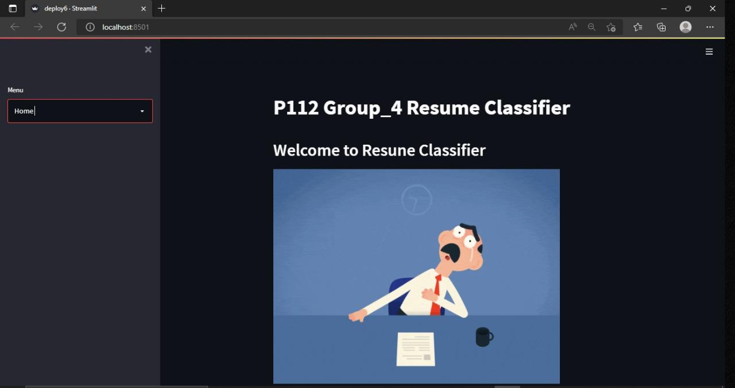
Deployment streamlit

Slide 18
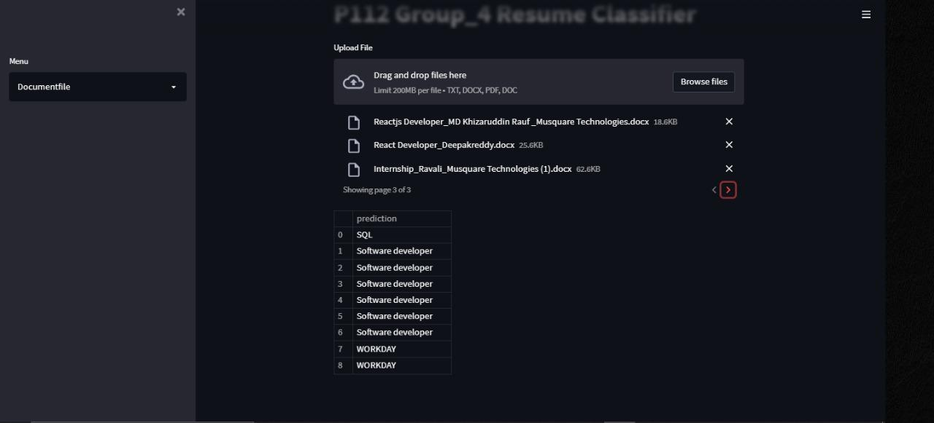
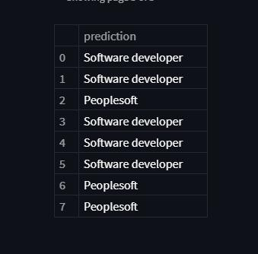
Prediction

Slide 19

Thank you

